Slide 1

Houzing
Name: Trieu Kim Nga
Date: Jan 23, 2025

Slide 2
What is Houzing ?
This project is a Real Estate Management System designed to facilitate property management, user interactions, and administrative functionalities

Slide 3
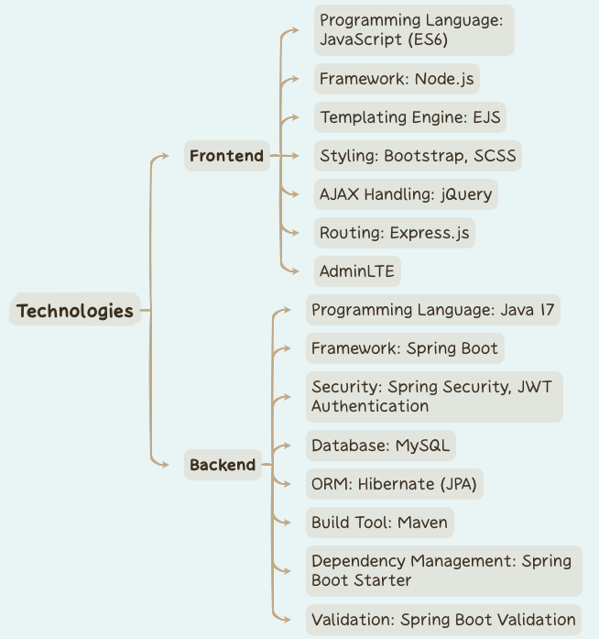
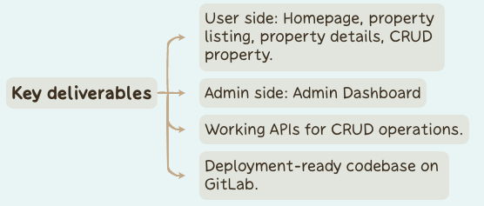

Overview

Slide 4
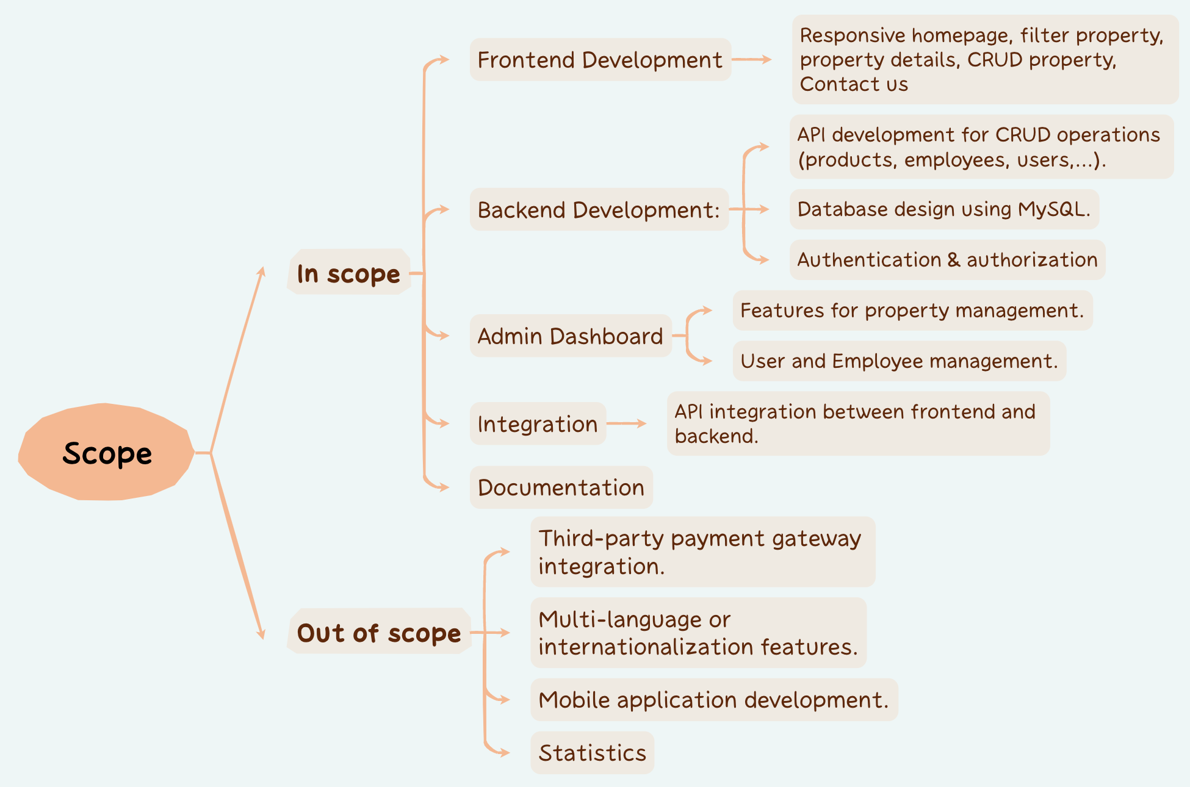
Features

Slide 5
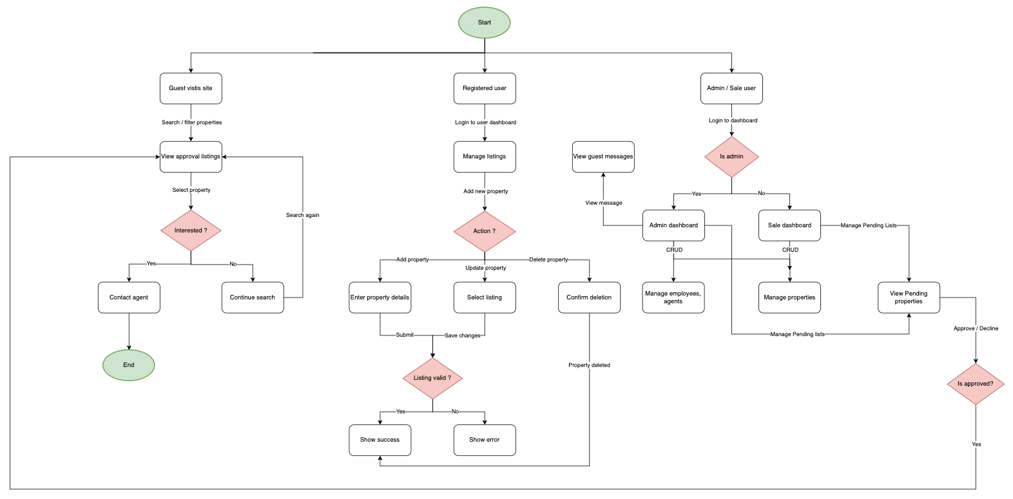

Slide 6
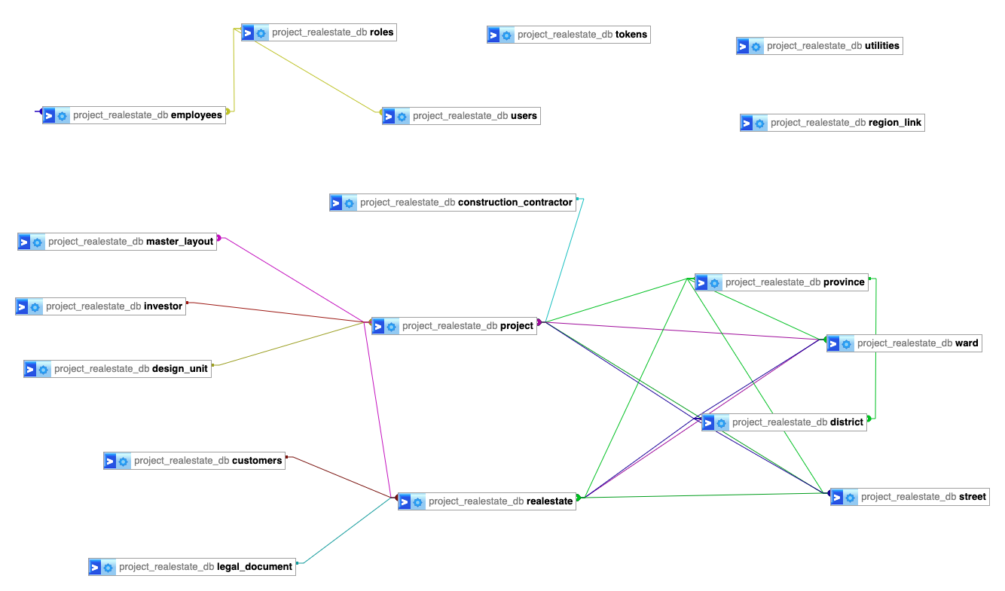

Slide 7
Demo

Slide 8
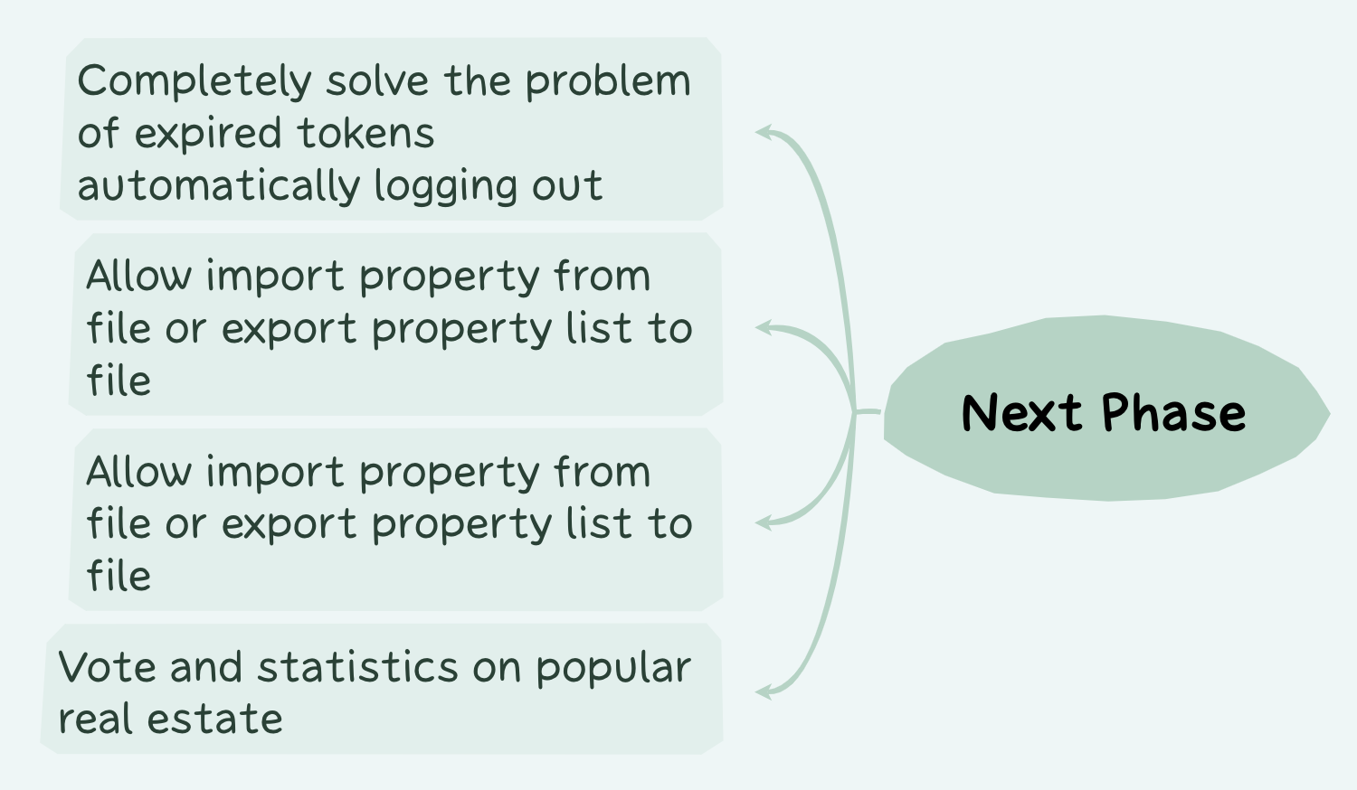
What’s next

